Slide 1
Causes of Death

Slide 2
A straightforward way to assess the health status of a population is to focus on mortality – or concepts like child mortality or life expectancy, which are based on mortality estimates. A focus on mortality, however, does not take into account that the burden of diseases is not only that they kill people, but that they cause suffering to people who live with them. Assessing health outcomes by both mortality and morbidity (the prevalent diseases) provides a more encompassing view on health outcomes. This is the topic of this entry. The sum of mortality and morbidity is referred to as the ‘burden of disease’ and can be measured by a metric called ‘Disability Adjusted Life Years‘(DALYs). DALYs are measuring lost health and are a standardized metric that allow for direct comparisons of disease burdens of different diseases across countries, between different populations, and over time. Conceptually, one DALY is the equivalent of losing one year in good health because of either premature death or disease or disability. One DALY represents one lost year of healthy life. The first ‘Global Burden of Disease’ (GBD) was GBD 1990 and the DALY metric was prominently featured in the World Bank’s 1993 World Development Report. Today it is published by both the researchers at the Institute of Health Metrics and Evaluation (IHME) and the ‘Disease Burden Unit’ at the World Health Organization (WHO), which was created in 1998. The IHME continues the work that was started in the early 1990s and publishes the Global Burden of Disease study.

Slide 3
Diseases mentioned in the Dataset:
Meningitis
Alzheimer's Disease and Other Dementias
Parkinson's Disease
Nutritional Deficiencies
Malaria
Drowning
Interpersonal Violence
Maternal Disorders
Drug Use Disorders
Tuberculosis
Cardiovascular Diseases
Lower Respiratory Infections
Neonatal Disorders
Alcohol Use Disorders
Self-harm
Exposure to Forces of Nature
Diarrheal Diseases -
Environmental Heat and Cold Exposure
Neoplasms
Conflict and Terrorism
Diabetes Mellitus –
Chronic Kidney Disease
Poisonings
Protein-Energy Malnutrition
Chronic Respiratory Diseases
Cirrhosis and Other Chronic Liver Diseases
Digestive Diseases
Fire, Heat, and Hot Substances
Acute Hepatitis

Slide 4
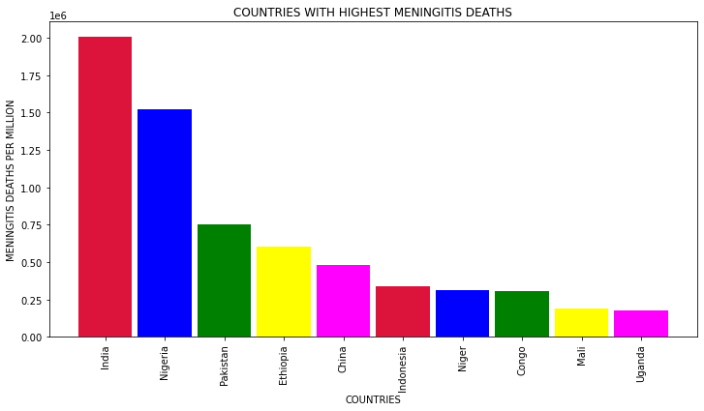
Countries with highest no. of people dying with diseases:

Slide 5
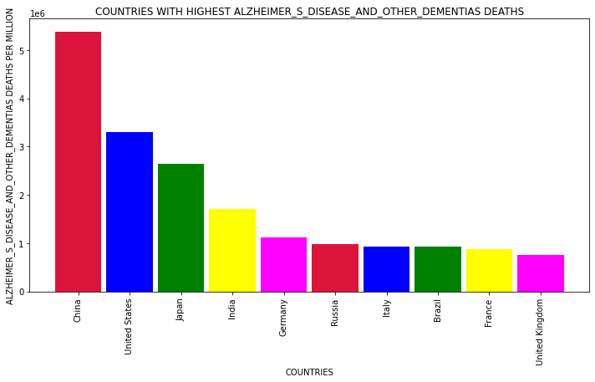
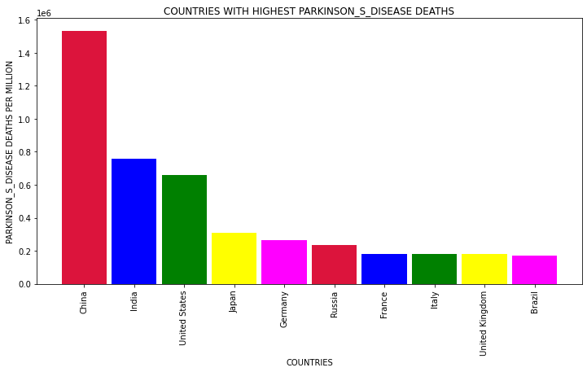
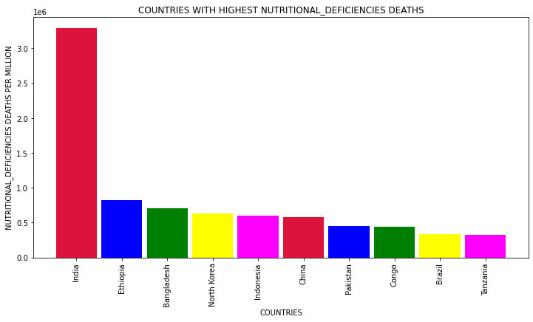
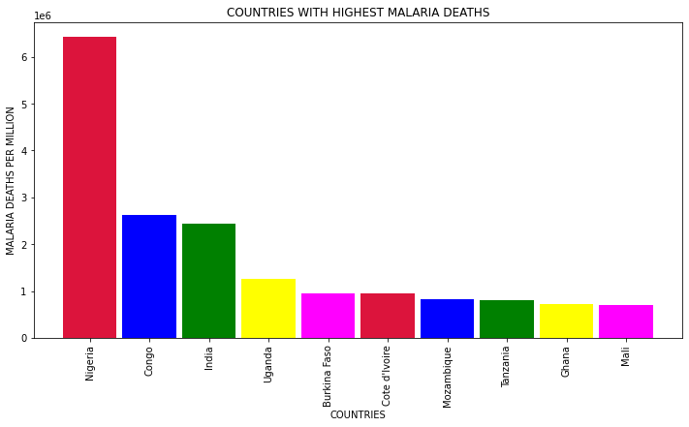

Slide 6
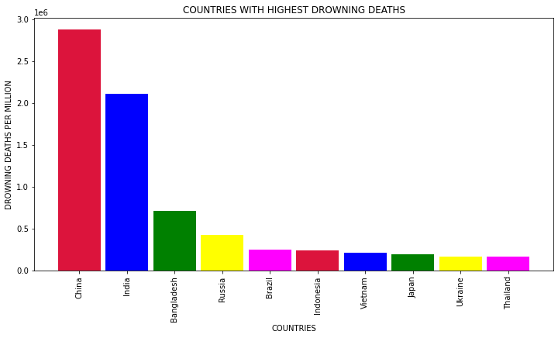
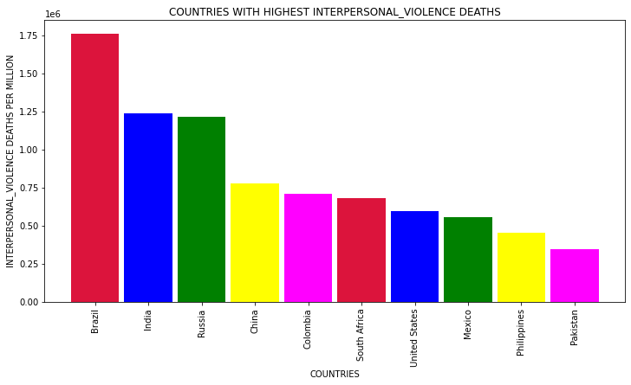
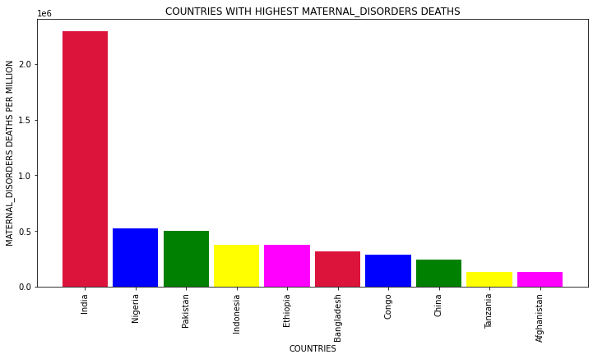
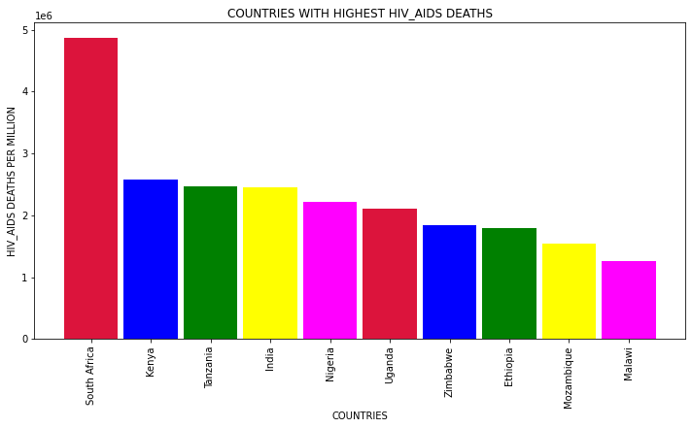

Slide 7
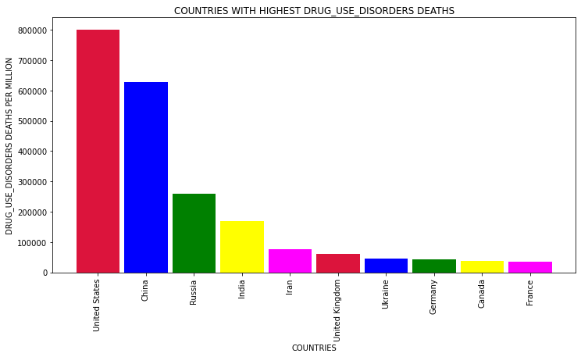
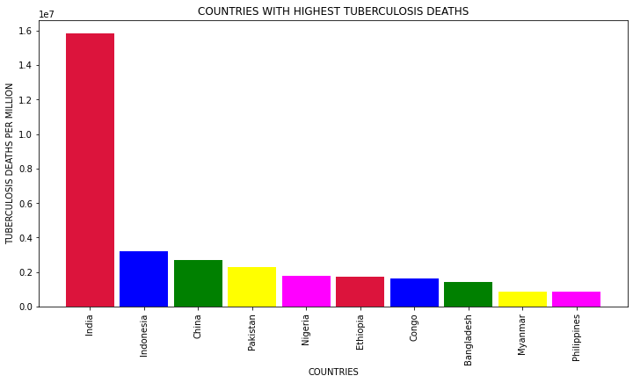
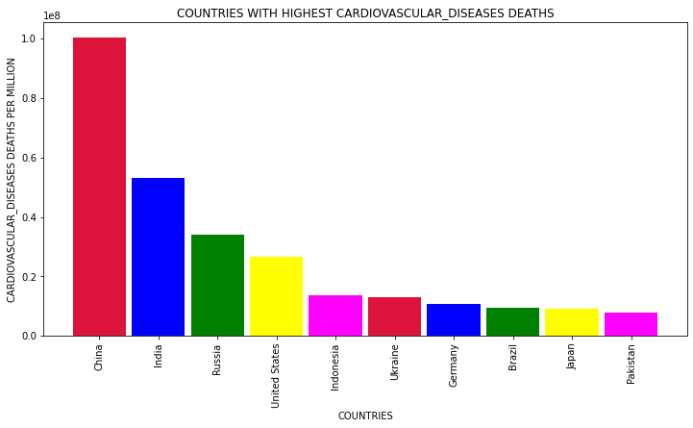
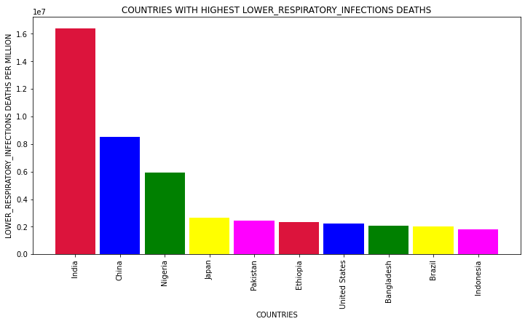

Slide 8
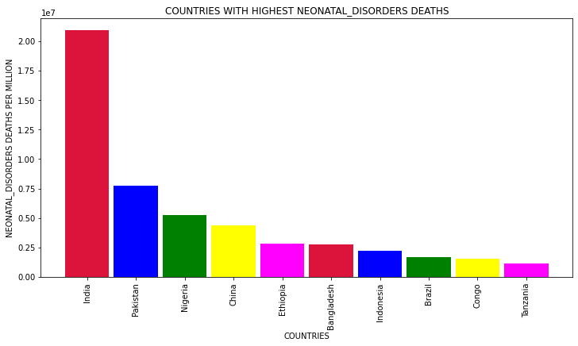
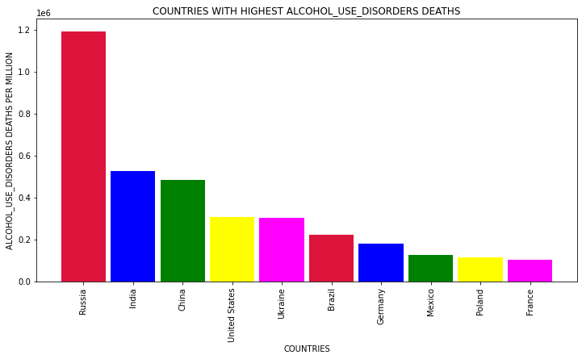
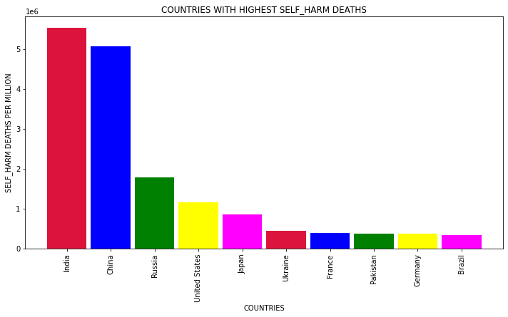
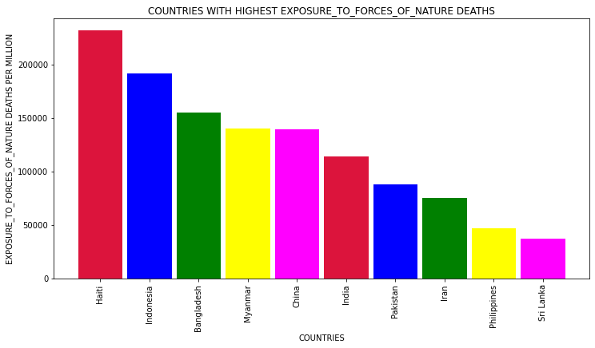

Slide 9
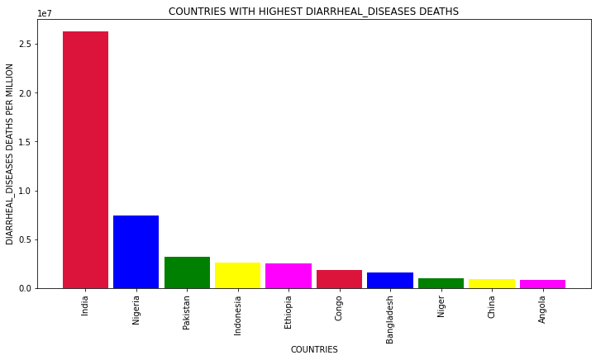
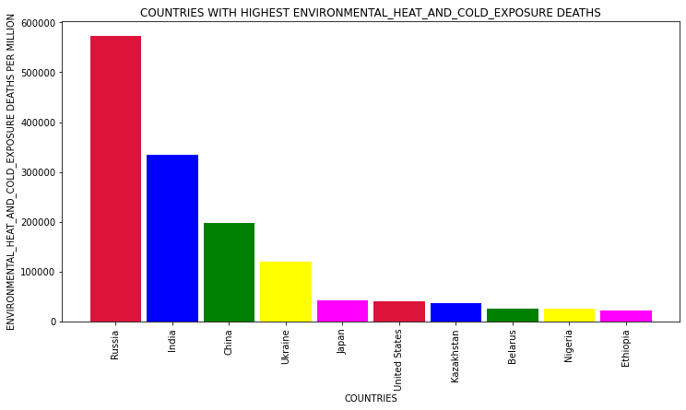
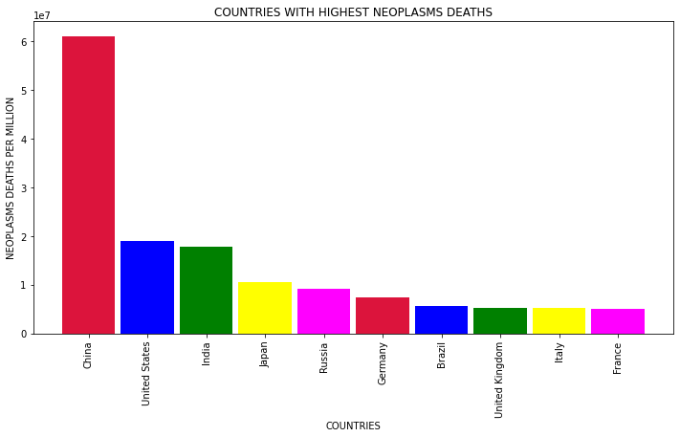
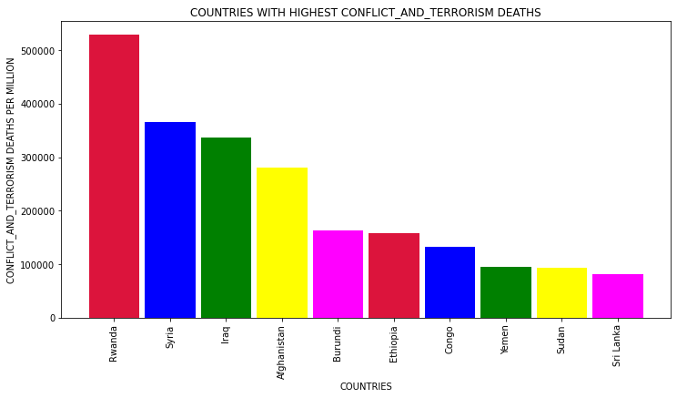

Slide 10
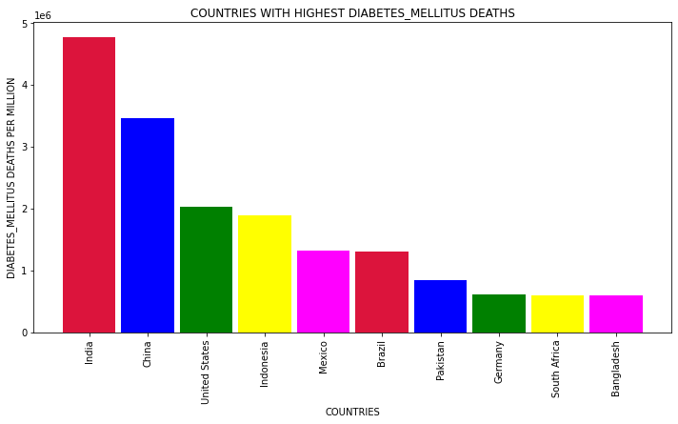
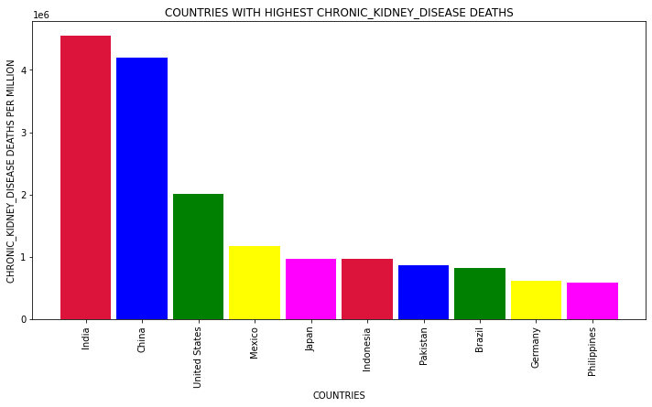
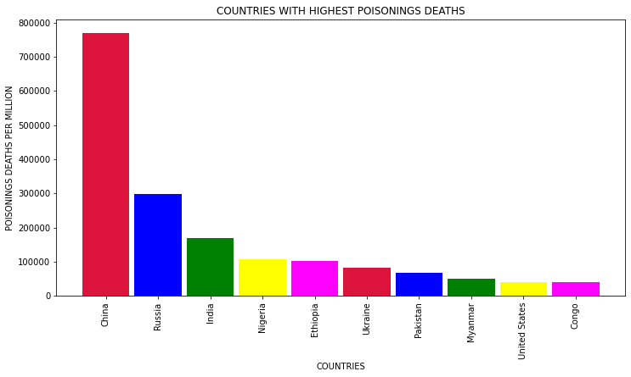
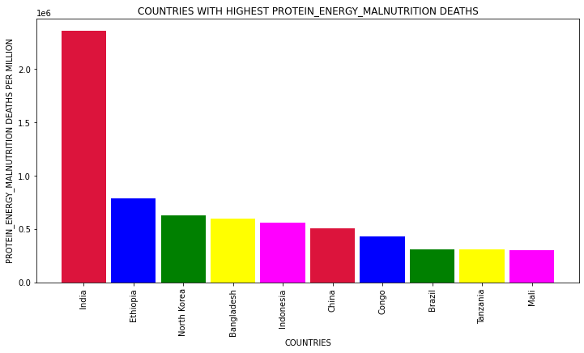

Slide 11
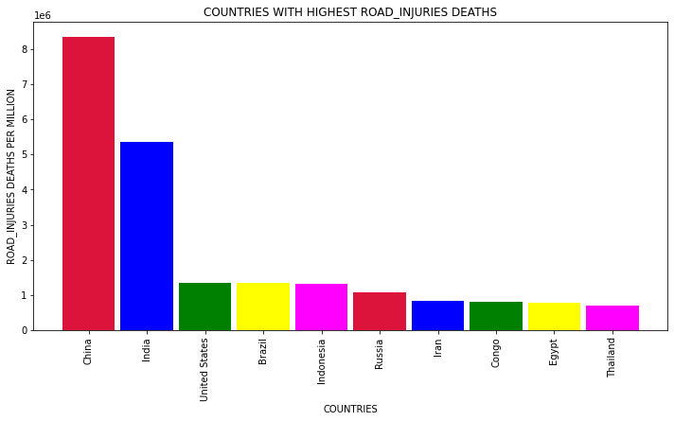
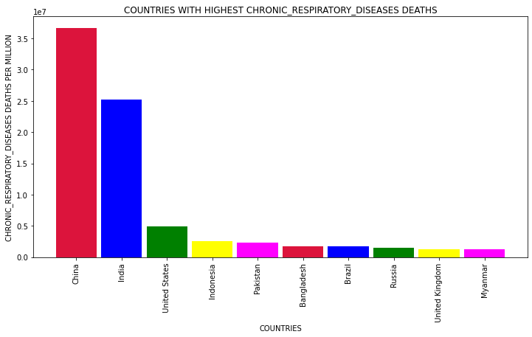
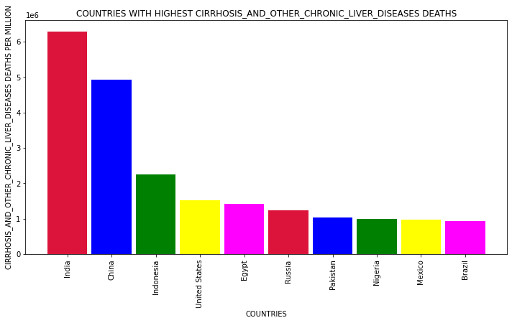
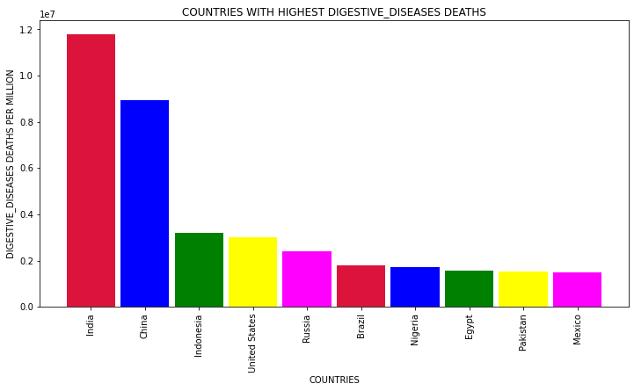

Slide 12
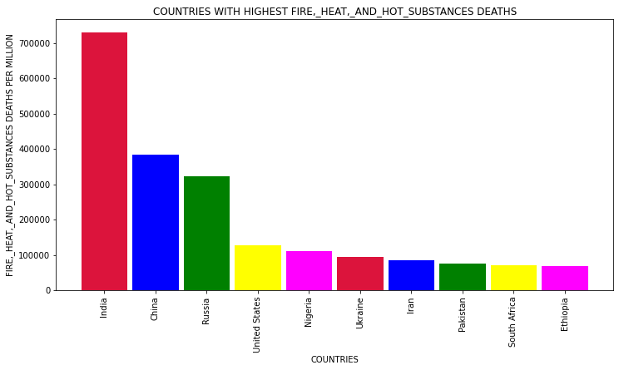
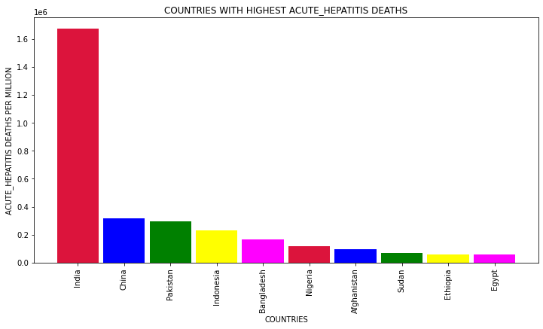

Slide 13
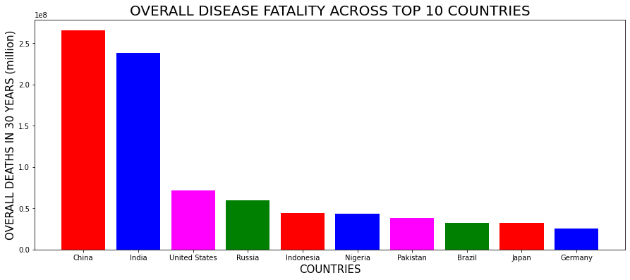
OVERALL DISEASE FATALITY ACROSS TOP 10 COUNTRIES

Slide 14
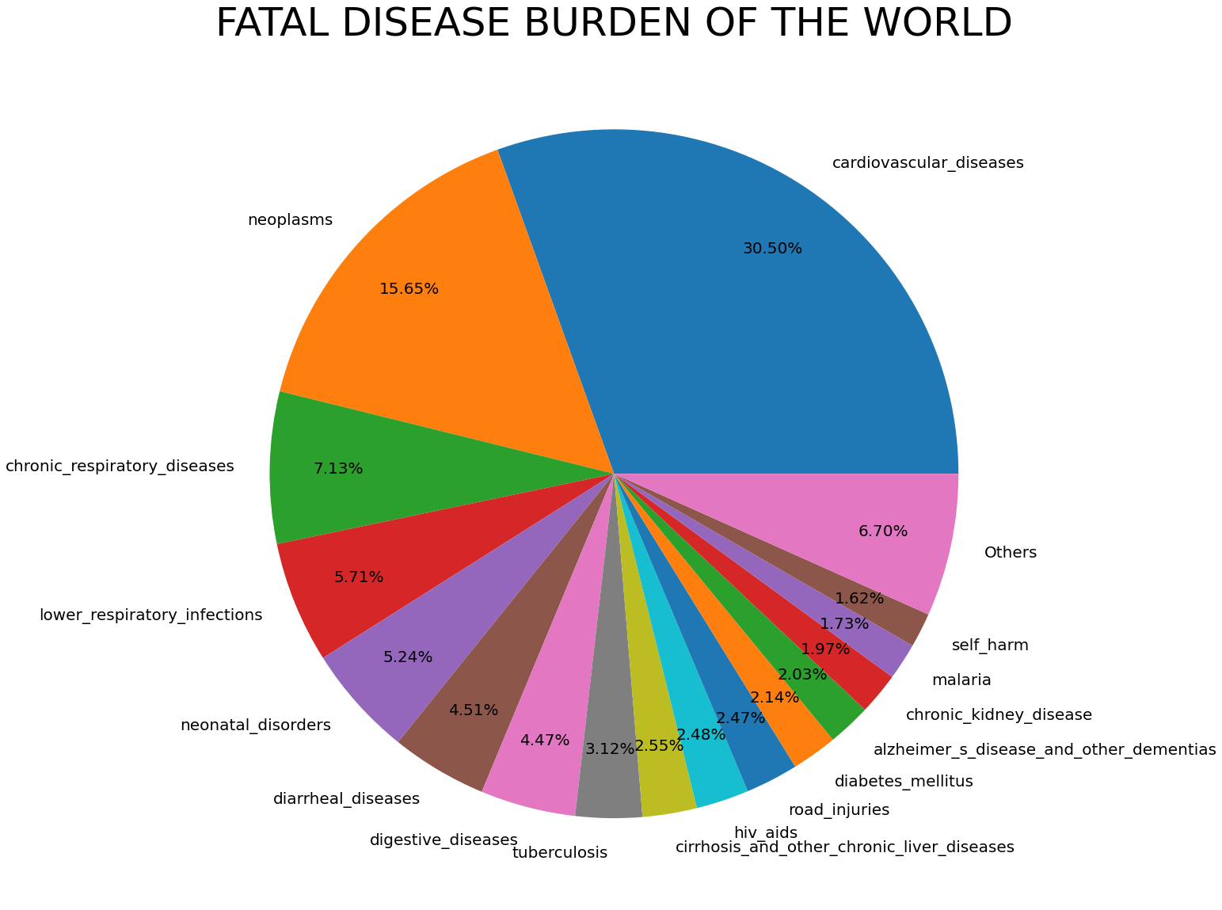
FATAL DISEASE BURDEN OF THE WORLD

Slide 15
Observations:
CHINA , INDIA AND USA faces the largest brunt of deaths due to diseases in the world Cardiovascular diseases , Neoplasms (Malignancy/Cancer) and Chronic Respiratory diseases (for example : Pneumonia) are the top 3 killer diseases in the world.
​

